Slide 1
Welcome

Slide 2
Activity
Let’s Play
Food Safety Password
1-2
Notes:
Instructor Notes
Do the Food Safety Password activity. This activity can be downloaded from ServSafe.com. Directions for using the activity are included with it.

Slide 4
Activity
Populations at High-Risk for Foodborne Illness
1-4
Notes:
Instructor Notes
Do the Populations at High-Risk for Foodborne Illness activity. This activity can be downloaded from ServSafe.com. Directions for using the activity are included with it.

Slide 5
1-5
Notes:
Instructor Notes
Play the Introduction to Food Safety DVD.

Slide 6
Additional Content
1-6
Notes:
Instructor Notes
Teach the additional content not included in the DVD by using the next several slides.

Slide 7
What Do You Think?
When is a foodborne illness considered an outbreak?
A. Two or more people have same symptoms after eating same food
B. Regulatory authorities have investigated
C. The outbreak is confirmed by laboratory analysis
1-7
Notes:
Instructor Notes
The answer is all of the above. An illness is considered an outbreak when:
Two or more people have the same symptoms after eating the same food
An investigation is conducted by state and local regulatory authorities
The outbreak is confirmed by laboratory analysis

Slide 8
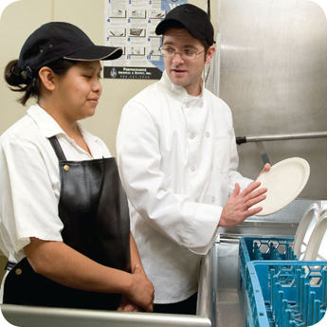
Challenges to Food Safety
Challenges include:
Time
Language and culture
Literacy and education
Pathogens
Unapproved suppliers
High-risk customers
Staff turnover
1-8
Notes:
Instructor Notes
Foodservice operations work hard to minimize foodborne illnesses. As a result of these efforts, foodborne illnesses have declined in recent years. However, operations still face many challenges to food safety.
Pressure to work quickly can make it hard to take the time to follow food safety practices.
Your staff may speak a different language than you do, which can make it difficult to communicate. Cultural differences can also influence how food handlers view food safety.
Staff often have different levels of education, making it more challenging to teach them food safety.
Illness-causing microorganisms are more frequently found on food that once was considered safe.
Food that is received from suppliers that are not practicing food safety can cause a foodborne-illness outbreak.
The number of customers at high risk for getting a foodborne illness is increasing. An example of this is the growing elderly population.
Training new staff leaves less time for food safety training.
The ServSafe program will provide the tools needed to overcome the challenges in managing a good food safety program.

Slide 9
The Cost of Foodborne Illnesses
The human cost of foodborne illness:
Lost work
Medical costs
Long-term disability
Death
1-9
Notes:
Instructor Notes
Foodborne illnesses cost the United States billions of dollars each year. National Restaurant Association figures show that one foodborne-illness outbreak can cost an operation thousands of dollars. It can even result in closure. Some of the business costs were highlighted in the video. There are also human costs, which are identified on the slide.

Slide 10
How Foodborne Illnesses Occur
Unsafe food is usually the result of contamination:
The presence of harmful substances in food
Contamination may come from:
Biological, chemical, and physical hazards
Unsafe practices
1-10
Notes:
Instructor Notes
Unsafe food is usually the result of contamination, which is the presence of harmful substances in food. To prevent foodborne illnesses, you must recognize the contaminants that can make food unsafe. These can come from pathogens, chemicals, or physical objects. They might also come from certain unsafe practices in your operation. Note: This will be discussed in depth in chapter 2.

Slide 11
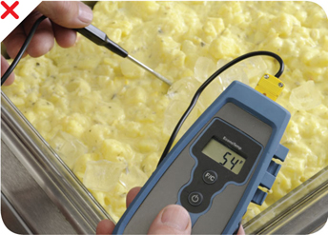
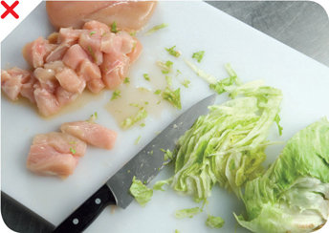
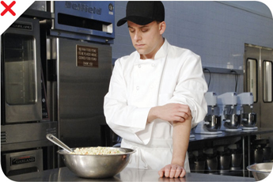
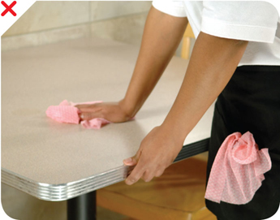
How Food Becomes Unsafe
Purchasing from
unapproved source
Time-temperature abuse
Cross-contamination
Poor personal hygiene
Poor cleaning
and sanitizing
1-11
Notes:
Instructor Notes
Purchasing food from unsafe sources is a risk factor for foodborne illness. The other risk factors for foodborne illness are related to four main practices: time-temperature abuse, cross-contamination, poor personal hygiene, and poor cleaning and sanitizing.

Slide 12
What Do You Think?
Is it OK for a foodservice operation to use food prepared in a private home?
A. Yes
B. No
Why?
Food prepared in a private home is considered to be from an unsafe source and must be avoided.
1-12
Notes:
Instructor Notes
The answer is B. Purchasing food from unsafe sources is a risk factor for foodborne illness. Keep in mind that food prepared in a private home is considered to be from an unsafe source and must be avoided.

Slide 13
How Food Becomes Unsafe
Poor cleaning and sanitizing:
Equipment and utensils are not washed, rinsed, and sanitized between uses
Food-contact surfaces are wiped clean instead of being washed, rinsed, and sanitized
Wiping cloths are not stored in a sanitizer solution between uses
Sanitizer solutions are not at required levels
Pg 1.5 SSF 6e
1-13
Notes:
Instructor Notes
Pathogens can be spread to food if equipment has not been cleaned and sanitized correctly between uses. This can happen in the ways indicated on the slide.

Slide 14
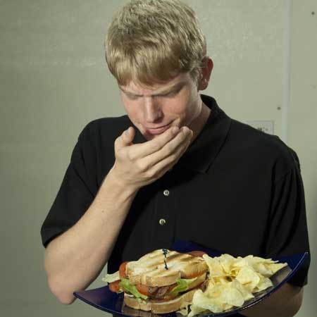
What Do You Think?
What is the problem?
A. Time-temperature abuse
B. Cross-contamination
C. Poor personal hygiene
D. Poor cleaning and sanitizing
1-14
Notes:
Instructor Notes
The answer is C. Sneezing or coughing on food can contaminate it. These habits are considered poor personal hygiene.

Slide 15
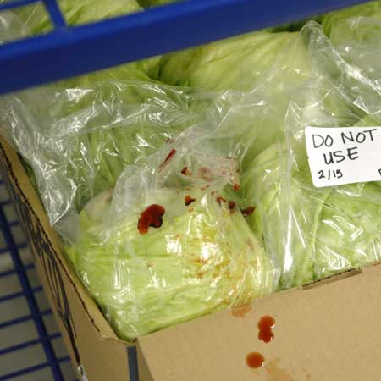
What Do You Think?
What is the problem?
A. Time-temperature abuse
B. Cross-contamination
C. Poor personal hygiene
D. Poor cleaning and sanitizing
1-15
Notes:
Instructor Notes
The answer is B. Blood from raw meat stored above the lettuce has cross-contaminated it. A foodborne illness can occur anytime contaminated food touches or drips fluids onto cooked or ready-to-eat food. This is cross-contamination.

Slide 16
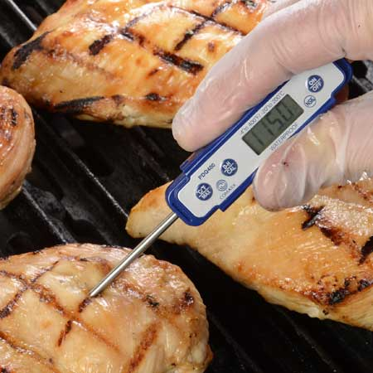
What Do You Think?
What is the problem?
A. Time-temperature abuse
B. Cross-contamination
C. Poor personal hygiene
D. Poor cleaning and sanitizing
Chicken breasts
1-16
Notes:
Instructor Notes
The answer is A. The chicken has not been cooked to a temperature high enough to kill pathogens. At this point it has been time-temperature abused and could cause a foodborne illness if served.

Slide 17
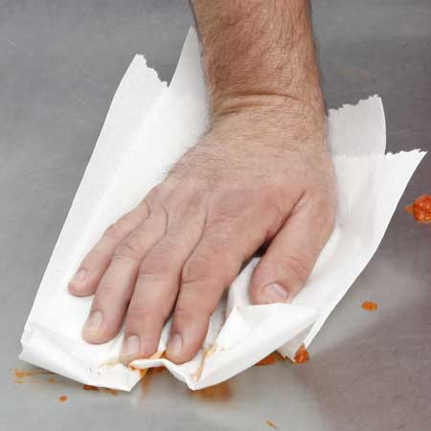
What Do You Think?
What is the problem?
A. Time-temperature abuse
B. Cross-contamination
C. Poor personal hygiene
D. Poor cleaning and sanitizing
Wiping prep table
between uses with single-use towel
1-17
Notes:
Instructor Notes
The answer is D. The employee appears to only be wiping the prep table clean rather than washing, rinsing, and sanitizing it. This would be considered poor cleaning and sanitizing and could cause a foodborne illness.

Slide 18
Populations at High Risk for Foodborne Illnesses
These people have a higher risk of getting a foodborne illness:
Elderly people
Preschool-age children
People with compromised immune systems
Pregnant women are not classified by the FDA as a high-risk population
1-18
Notes:
Instructor Notes
The immune system is the body’s defense against illness.
Elderly people are at high risk because their immune systems have weakened with age.
Very young children are at high risk because they have not built up strong immune systems.
People with compromised immune systems. Certain medical conditions and medications can weaken a person’s immune system. These include:
Cancer or receiving chemotherapy
HIV/AIDS
Transplants

Slide 19
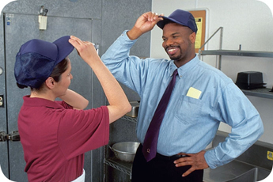
Keeping Food Safe
Focus on these measures:
Controlling time and temperature
Preventing cross-contamination
Practicing good personal hygiene
Purchasing from approved, reputable suppliers
Cleaning and sanitizing
1-19
Notes:
Instructor Notes
Set up standard operating procedures that focus on these areas. The ServSafe program will show you how to design these procedures.

Slide 20
Keeping Food Safe
Training and monitoring:
Train staff to follow food safety procedures
Provide initial and ongoing training
Provide all staff with general food safety knowledge
Provide job-specific food safety training
Retrain staff regularly
1-20
Notes:
Instructor Notes
As a manager, your job is more than just understanding food safety practices and creating the necessary procedures. You also must train your staff to follow these procedures.
Staff should be trained when they are first hired and on an ongoing basis. Your entire staff needs general food safety knowledge. Other knowledge will be specific to the tasks performed on the job. For example, everyone needs to know the correct way to wash their hands. However, only receiving staff need to know how to inspect produce during receiving.
Staff need to be retrained in food safety regularly.

Slide 21
Keeping Food Safe
Training and monitoring:
Document training
Monitor staff to make sure they are following procedures
Retrain employees who complete tasks incorrectly
Corrective Action = Correcting situation immediately when an employee does a task incorrectly.
1-21
Notes:
Instructor Notes
When a food handler completes food safety training, document it.
Once staff are trained, monitor them to make sure they are following procedures.
At times, you may notice employees doing tasks incorrectly. Each incorrect task could lead to an increase in risk. When this happens, it is important to correct the situation immediately. This is called corrective action. If an employee often completes a task incorrectly or if multiple employees complete a task incorrectly, they should be retrained.

Slide 22
Agencies Responsible for Preventing Foodborne Illness
Food and Drug Administration (FDA):
Inspects all food except meat, poultry, and eggs
Regulates food transported across state lines
Provides technical support and training
Issues the Food Code
Regulates Restaurants, Retail Food Stores, Vending Operations, Schools and Daycare Centers, and Hospitals and Nursing Homes
The FDA Food Code:
Provides recommendations for food safety regulations
Created for city, county, state, and tribal agencies
Is recommendation not law
1-22
Notes:
Instructor Notes
The FDA issues a Food Code. This science-based code provides recommendations for food safety regulations. The Food Code was created for city, county, state, and tribal agencies. These agencies regulate foodservice for the following groups:
Restaurants and retail food stores
Vending operations
Schools and day care centers
Hospitals and nursing homes
Although the FDA recommends that states adopt the Food Code, it cannot require it.

Slide 23
Agencies Responsible for Preventing Foodborne Illness
The U.S. Department of Agriculture (USDA):
Regulates and inspects meat, poultry, and eggs
Regulates food transported across state lines
Regulates food involving more than one state
The Centers for Disease Control and Prevention (CDC)
The Public Health Service (PHS):
Assist the FDA, USDA, and state and local health departments
Conduct research into causes of foodborne-illness outbreaks
Assist in investigating outbreaks
1-23

Slide 24
Agencies Responsible for Preventing Foodborne Illness
State and Local Regulatory Authorities:
Write or adopt codes regulating retail and foodservice operations
Codes may differ from FDA Food Code
Food safety responsibilities include:
Inspecting operations
Enforcing regulations
Investigating complaints and illnesses
Issuing licenses/permits
1-24
Notes:
Instructor Notes
Codes may differ from the FDA Food Code, because these agencies are not required to adopt it.

